Slide 1
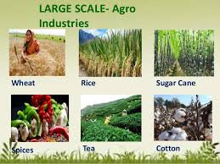
OUR INDUSTRIES

Slide 2
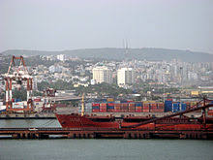
LARGE SCALE INDUSTRY ship building

Slide 3
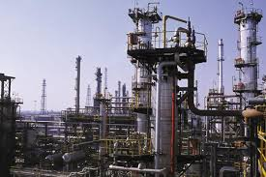
OIL REFINERY

Slide 4
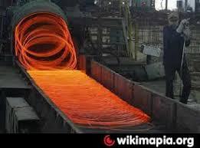
IRON AND STEEL

Slide 5
TEA INDUSTRY

Slide 6
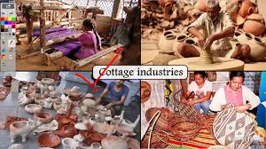
SMALL SCALE INUSTRY

Slide 7
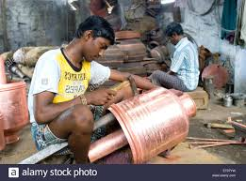
UTENSILS

Slide 8
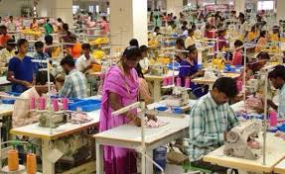
GARMENTS

Slide 9
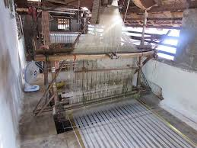
COTTAGE INDUSTRY

Slide 10
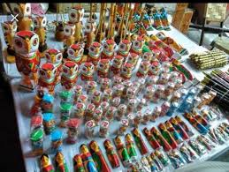
TOY MAKING

Slide 11
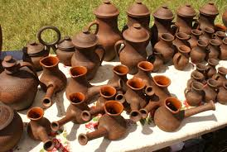
POT MAKING

